Slide 1
Experimenting with Low-Overhead OpenMP Runtime on BG/Q
Yunchuan Ran
COMP 522
3/1/2022

Slide 2
Topics
Introduction to OpenMP
Some Demos
Parallel Constructs of OpenMP
Analyze Overhead
Optimization
Measurements
Summary

Slide 3
Introduction to OpenMP
Introduction
Main Components

Slide 4
Introduction
OpenMP (Open Multi-Processing) is an application programming interface (API) that supports multi-platform shared-memory multiprocessing programming in C, C++ and Fortran.
OpenMP uses fork-join execute model
Begin with only one thread (master thread)
Derive many threads (worker threads) when parallel computing is required
Return control to master thread when parallel execution is complete
Parallel region
Parallel region
Thread 0
Master thread
Thread 0
Thread 1
Thread 1
Thread 2
fork
Thread 2
join
Thread 3

Slide 5
Main Components
OpenMP 3.1 API consist three main components:
Compiler directives
E.g., “#pragma omp parallel”
“pragma” is a kind of preprocessing directives used to set compiler’s state or instruct compiler to perform some specific actions
Runtime library functions
E.g., “omp_get_num_threads” gets number of threads
Environment variable
E.g., sh/bash: “export OMP_NUM_THREADS = 8”
#pragma omp | Directive-name | [clause, …] | Newline
Required for all OpenMP C/C++ directives | A valid OpenMP directive, e.g., parallel, parallel for | Optional, can be repeated in any order, e.g., private(…), shared(…) | Required, must before the structured block contained in this directive

Slide 6
Some Demos
Focus
#pragma parallel
#pragma parallel for
Private and shared
Firstprivate
Lastprivate

Slide 7
Focus
Main focus:
#pragma parallel
#pragma parallel for
private, shared
firstprivate
lastprivate

Slide 8
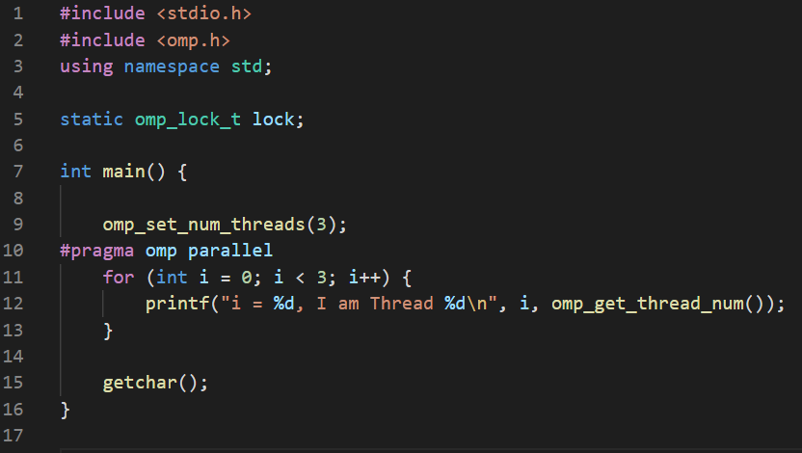
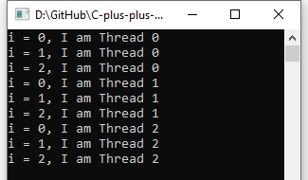
#pragma parallel

Slide 9
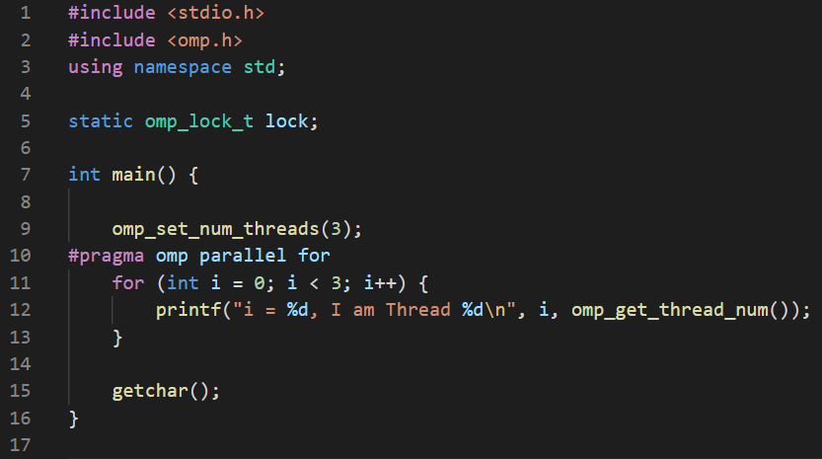
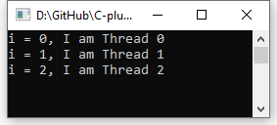
#pragma parallel for

Slide 10
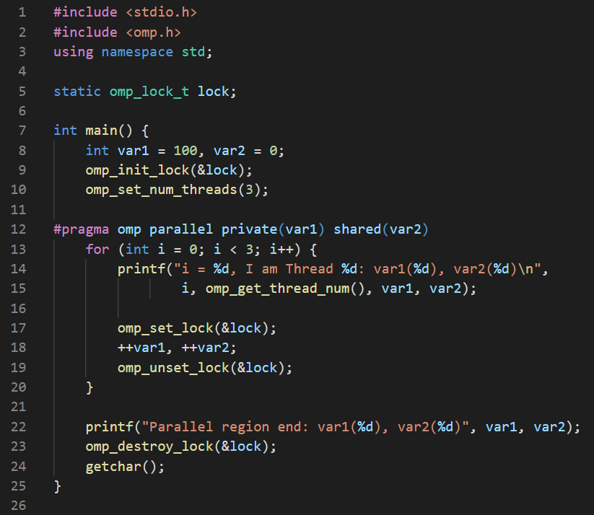
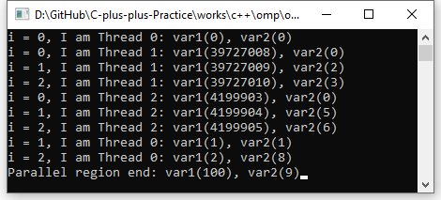
Private and shared

Slide 11
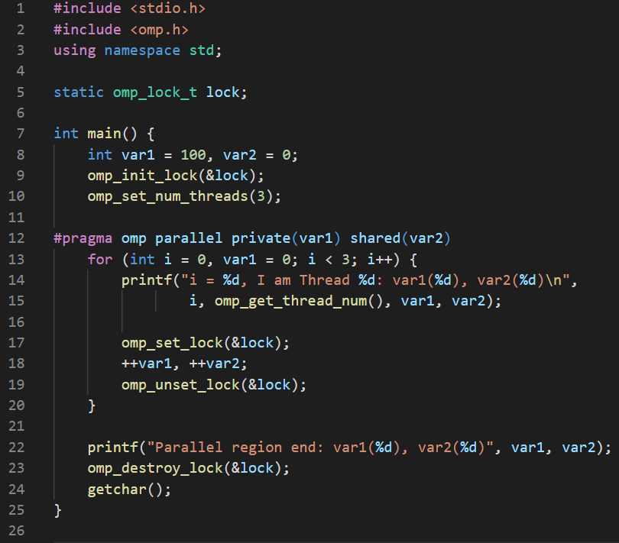
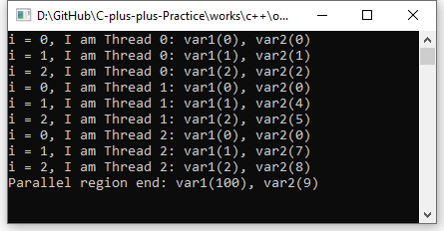
Private and shared

Slide 12
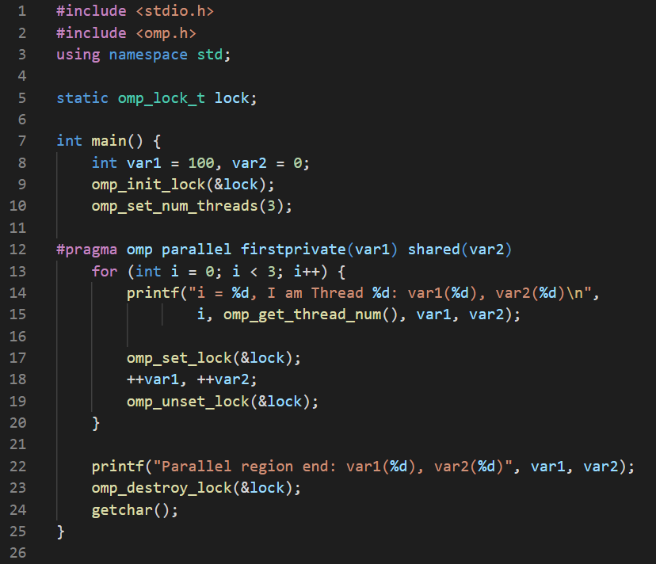
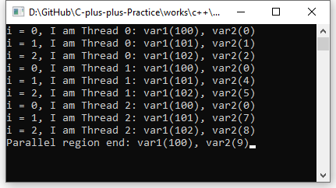
Firstprivate

Slide 13
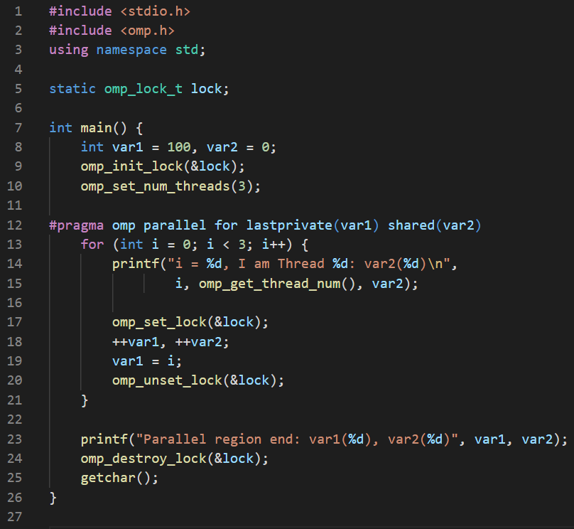
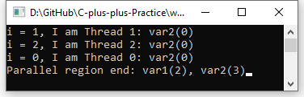
Lastprivate

Slide 14
Parallel Constructs of OpenMP
Overview of OpenMP Workflow
Step1: find avail threads
Step2: assign thread IDs
Step3: assign work
Other steps

Slide 15
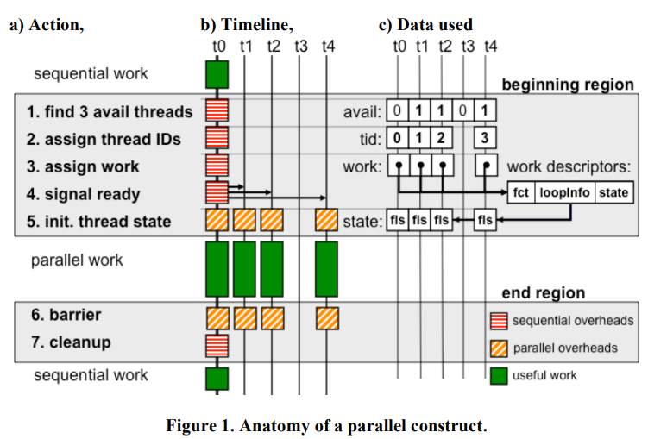
Overview of OpenMP Workflow
Master thread (t0)
Worker thread (t1, t2, t4)
Parallel region construct:
Find 3 avail threads
Assign thread IDs
Assign work
Signal ready
Init. Thread state
Parallel work
Parallel region deconstruct:
Barrier
Cleanup

Slide 16
Step1: find avail threads
Identify which threads are available
E.g., Bitvector represents threads’ states
Select threads and mark them busy
Mutex is required

Slide 17
Step2: assign thread IDs
Master thread assigns to each thread its own distinct thread number (TID)
Number 0 is reserved for the master thread
Successive integer numbers are assigned to other worker threads
Each thread in the team can access their TIDs
E.g., determine which thread is responsible to compute which subset of a given parallel loop

Slide 18
Step3: assign work
Many computing environments encapsule the parallel work in a compiler-generated function
Address is inserted in the work descriptor
Other information (loop bounds, ordered clauses) can be entered into work descriptor too
Work-descriptor identifier (WID) is a pointer to the work descriptor
TID and WID are stored as a globally-accessible array pair
Write by master thread, read by each thread in the team
One pair per thread in the system

Slide 19
Other steps
Step 4: awake the worker threads
Step 5: initialize worker threads’ states
Copy the global work description data in worker threads’ context
Step 6: OpenMP requires execute a synchronization barrier
The worker threads are placed back on the pool of available threads
Step 7: The master thread performs further cleanup
E.g., update the global bitvector

Slide 20
Analyze Overhead
Overhead of Parallel Construct

Slide 21
Overhead of Parallel Construct
Two types of subtasks:
The ones executed sequentially by master threads (red boxes)
The ones executed in parallel by every threads in the team (orange boxes)
Step 1-4 and 7:
Most critical subtasks
Have work that is proportional to the number of threads in the team (TNUM)
E.g., the master thread must write a unique number of threads in the team
Step 5:
Consist of communicating the work-descriptor entry from the master to the worker’s local cache
sensitive to the size of the work descriptor internal representation

Slide 22
Optimization
Near Constant-Time Thread-Allocation
Eliminating Assignment Notification Overheads
Reducing the “Go-Ahead” Signaling Overheads
Improved Application-Runtime Interface

Slide 23
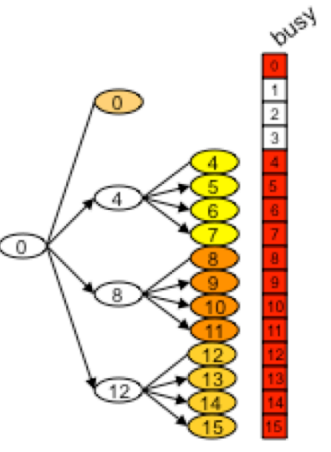
Near Constant-Time Thread-Allocation
Main idea: reuse the same thread allocation for future parallel regions
TSET(t): a set of worker threads for a given master thread t.
E.g., TSET(0) = {t5, t8, t12}, TSET(4) = {t5, t6, t7}
The state of ‘busy’ bitvector indicates the state of threads

Slide 24
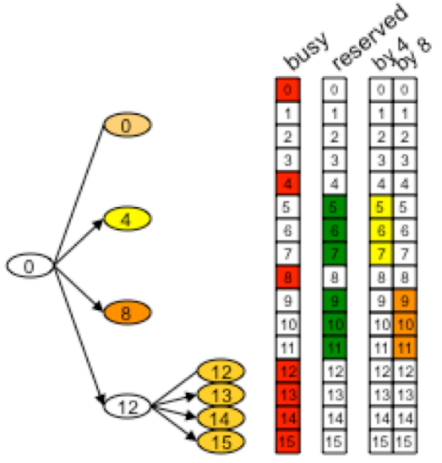
Near Constant-Time Thread-Allocation
Key idea: preserve the TSET information past the deallocation of a team
Consider t4:
Preserve its TSET(t4) = {t5, t6, t7} in the private execution context as its team is deallocated
“reserved” bitvector: the union of all thread sets currently preserved by any master threads in the system

Slide 25
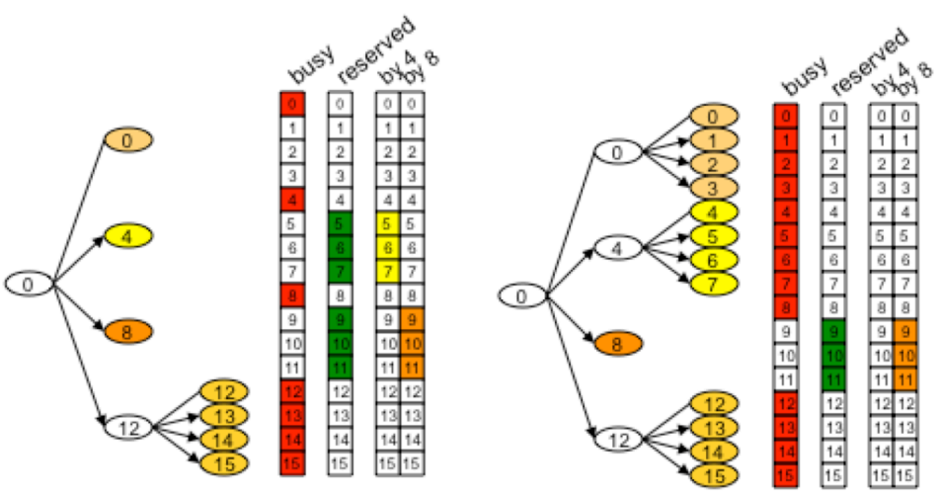
Near Constant-Time Thread-Allocation
Example:
Format a new four-thread team for Thread t0:
Check the union of both the busy and reserved bitvector in left image
Determine the 3 remaining threads (t1, t2, t3)
Allocate thread t4 in constant time:
Reuse prior TSET(t4) = {t5, t6, t7} assignment saved in its private context
T4 need to ensure its past allocation has not been invalidated
Otherwise bring some problems if t0 requested a larger team (more than 4)

Slide 26
Near Constant-Time Thread-Allocation
Introduce globally accessible generational-counter to ensure correctness
Save the current value of the global generational-counter as local, when master thread preserves an allocation
Increment the global generational-counter when use threads marked as reserved
Only need to check whether the local and global values of the generational-counter match
If match, allocation is valid
Otherwise, allocation may not be valid and thus discarded
Work well in practice and has constant-time overheads

Slide 27
Eliminating Assignment Notification Overheads
Main idea: remove overhead of assigning TID and WID by reusing of prior thread allocation
The new request is performed by the same master thread
The new request asks for a team of size no larger than the size of the cached team allocation
Ensure that do not need to modify the WIDs of the threads participating in the team
Set aside the work-descriptor entry associated with a parallel region when freeing and preserving the thread allocation
Reuse the work-descriptor entry set aside when successfully reusing the prior thread allocation
No need to update the assignment table

Slide 28
Reducing the “Go-Ahead” Signaling Overheads
General methods to signal the worker threads to exit their idling loop:
Use pairs of mutex and condition if runtimes built on top of a pthread library
Use a per-thread variable to communicate master thread (write) and worker threads (read)
Introduce a single globally-accessible bitvector (“activate vector”):
Perform atomic-xor of the TSET(t) to activate threads
Idling threads recall the last value of its bit in the activate bitvector
If flipped, then there is new work to be fetched
Work can be found by accessing the corresponding (TID, WID) pair in the global assignment table

Slide 29
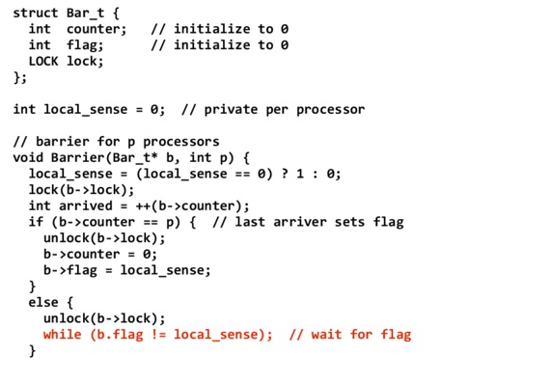
Reducing the “Go-Ahead” Signaling Overheads
Prior method
New method
Introduce a single globally-accessible bitvector (“activate vector”):
Perform atomic-xor of the TSET(t) to activate threads
Idling threads recall the last value of its bit in the activate bitvector
If flipped, then there is new work to be fetched
Work can be found by accessing the corresponding (TID, WID) pair in the global assignment table
Atomic_xor(&goahead, 1<<k)
Atomic_xor(&goahead, (1<<k) | (1<<i) | (1<<j))

Slide 30
Improve Application-Runtime Interface
#pragma omp parallel
#pragma omp parallel private(a, b, c) shared(d)
Modify the interface between the application and the OpenMP runtime can also result in lower overheads.
Localize private internal runtime data pointers of thread can be expensive
Firstly, provide this pointer to the application
Then the application pass this pointer back when performing a subsequence call to the runtime
Default values for a long list of possible switches can be expensive
Provide two entry points
One accepting all legal switches
One assuming default values
Many special cases in the runtime can be statically eliminated by the second entry point

Slide 31
Measurements
Measurement Method
Reduction in Overheads Due to Proposed Techniques

Slide 32
Measurement Method
Use EPCC benchmark to measure the overheads due to synchronization and loop scheduling
Compare sequentially executing time of one unit of work to the time taken for the same code executing in parallel TNUM units of work
Perform in the same runtime code-base
Compile with the same option
-o3 with inter-procedural analysis and aggressive inlining
Always fully populate the hardware threads of each core
E.g., 4 thread use one core, 16 thread use 4 cores and 64 thread use 16 cores

Slide 33
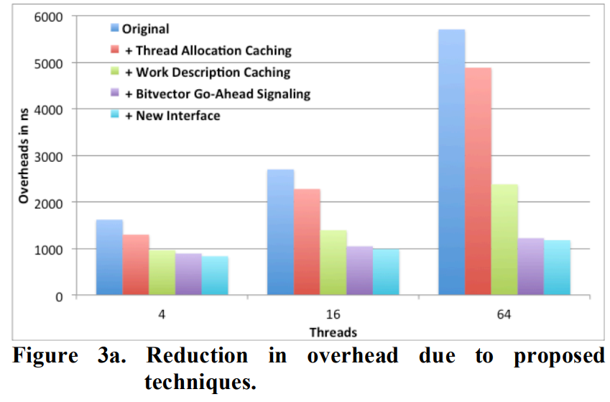
Reduction in Overheads Due to Proposed Techniques
Reuse past thread allocation:
Reductions are 300ns, 400ns, and 800ns
Reuse assignment notification:
Cut overheads by a factor 1.7x, 1.9x, and 2.4x
Use XOR operation of “Go-Ahead”:
Linear component to the overheads (others as the same)
Interface optimizations:
Only lower the overhead by a few percent

Slide 34
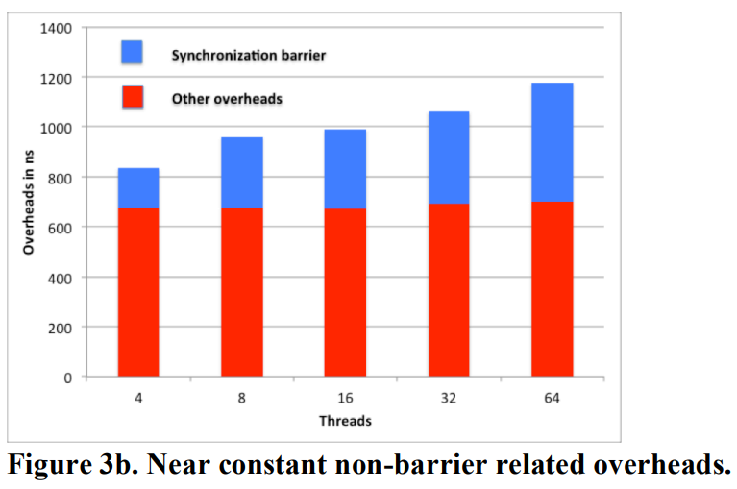
Reduction in Overhead Due to Proposed Techniques
Synchronization barrier:
Proportional with the number of threads to synchronize
Other overheads:
Acquire 2 locks to update the thread allocation table
Handle all the OpenMP internal control variables
Non-synchronization overheads are reduced greatly
64 thread parallel region are less than prior 4 thread

Slide 35
Summary
Introduce some basics of OpenMP
Demonstrate some OpenMP demos
Look detail in parallel construct of OpenMP
Analyze the overheads of parallel construct of OpenMP
Make some optimizations
Optimize thread allocation
Optimize assignment notification (TID, WID, etc.)
Optimize “Go-Ahead” signal overheads
Optimize application-runtime interface
Analyze the results

